Slide 1
Respiration

Slide 2
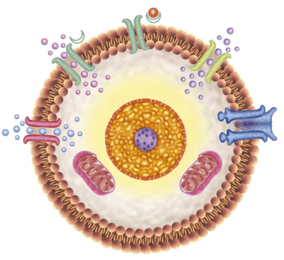
Every cell in your body has a function, and all of those cells need energy to perform those functions.
That energy is taken from a reaction called respiration.

Slide 3
Respiration is the decomposition of glucose in our cells. Breaking glucose down releases a large amount of energy that our cells can use to perform their functions.
Most respiration reactions in plants and animals are a process called aerobic respiration. It looks like this:
glucose + oxygen → carbon dioxide + water
C₆​H₁₂​O₆​+6O₂​→6CO₂​+6H₂​O

Slide 4
Some cells will undergo a different process called anaerobic respiration.
This is also a decomposition of glucose, which will create a large amount of energy, but this process does not involve oxygen.
Glucose → Lactic acid + Energy
C_{6​}H₁₂​O₆​→2C₃​H₆​O₃​+ Energy
Instead glucose just breaks down to lactic acid. Anaerobic respiration happens in our cells during exercise, and the lactic acid can sting, giving us a stitch.

Slide 5
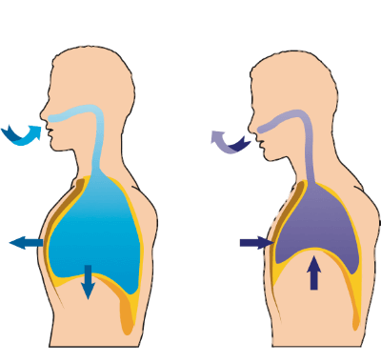
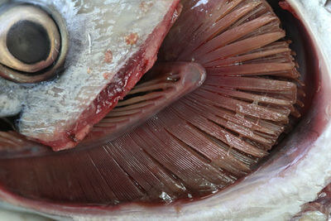
Respiration is an exothermic combustion reaction, so it needs oxygen to react.
Plants get oxygen from photosynthesis, animals get oxygen by breathing (or gills if you're a fish).

Slide 6
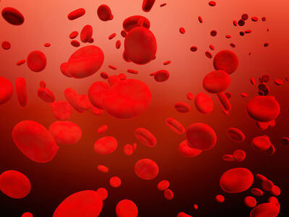
In humans, we take oxygen from the air and glucose from our food. Both are transported by our blood stream to our cells.

Slide 7
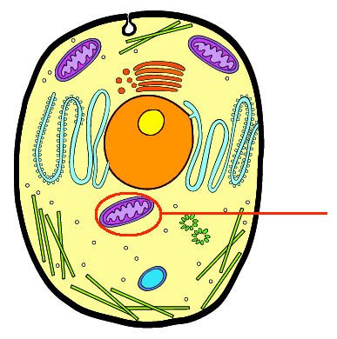
The mitochondria are small structures inside a cell which carry out aerobic respiration.
Blood sends oxygen and glucose into the body's cells, and then they are carried through the cells into their mitochondria, shown below:

Slide 8
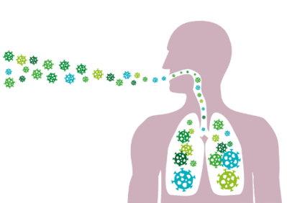
The carbon dioxide and water products are re-released into our blood.
Both products are taken back to the lungs where they diffuse back into the air when we breathe out.

Slide 9
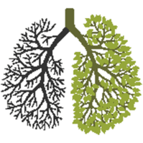
The glucose and oxygen created by photosynthesis are sent to every cell in the plant.
In the mitochondria of these cells, carbon dioxide and water are produced by respiration.

Slide 10
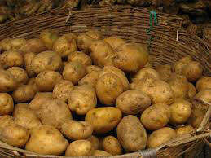
Plants release much less carbon dioxide than they take in. This is because they don't just use glucose for respiration.
It also is stored as: cellulose, starch, plant oils, proteins, sucrose and vitamins.

Slide 11
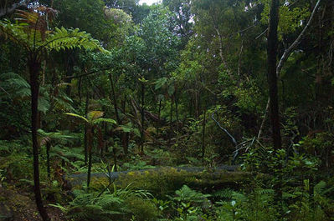
Most of the carbon dioxide used by plants is stored inside them through the other uses of glucose.
For this reason plants are called carbon sinks. Carbon is taken from the atmosphere and 'buried' by plants.

